Slide 1


FAIR Data Management for
Materials Scientists
José M. (Chema) Pizarro
jose.pizarro@physik.hu-berlin.de
@ JosePizarroB
https://nomad-lab.eu/nomad-lab/
https://www.fairmat-nfdi.eu/fairmat/

Slide 2
Schedule
Introduction to Research Data Management in Materials Science (~30min)
FAIRmat and the NOMAD Archive & Repository (~20min)
Break (~10min)
Hands-on NOMAD (~30min)

Slide 3

But first…
Let’s get to know each other a little bit 😊

Slide 4
Schedule
Introduction to Research Data Management in Materials Science (~30min)
FAIRmat and the NOMAD Archive & Repository (~20min)
Break (~10min)
Hands-on NOMAD (~30min)

Slide 5
Introduction to RDM in Materials Science
What is RDM?
Activities related with research data handling: collection, storage, sharing, analyzing, etc.
Different type of research fields == different type of research data (discipline-specific).
Essential for a responsible conduct in research.

Slide 6

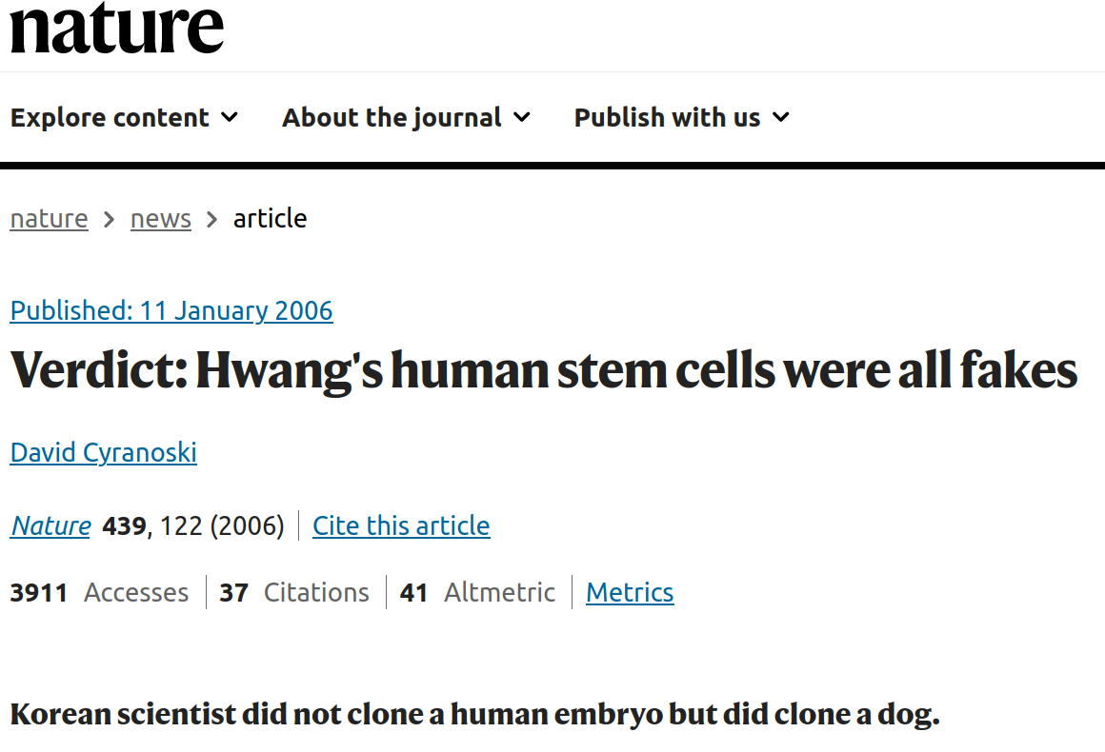
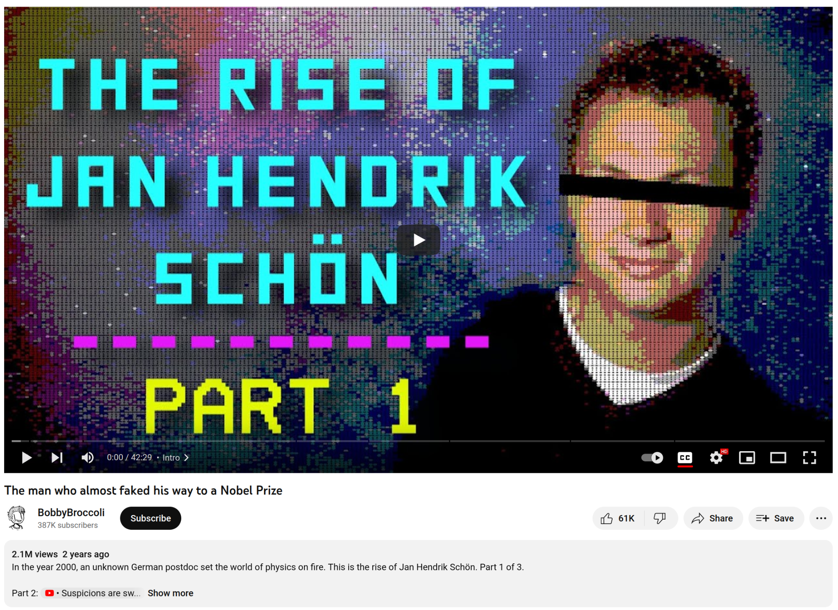
Introduction to RDM in Materials Science
Why is RDM important?
Key for verifiability, reproducibility and transparency of scientific results: an important anti-fraud mechanism.

Slide 7
Introduction to RDM in Materials Science
Why is RDM important?
Key for verifiability, reproducibility and transparency of scientific results: an important anti-fraud mechanism.
Reduction of scientific errors.
Faster retrieval of data and information for reusability → AI and Machine-Learning predictions.
Prevents data loss, allowing long-term availability.
Important to get funding…

Slide 8
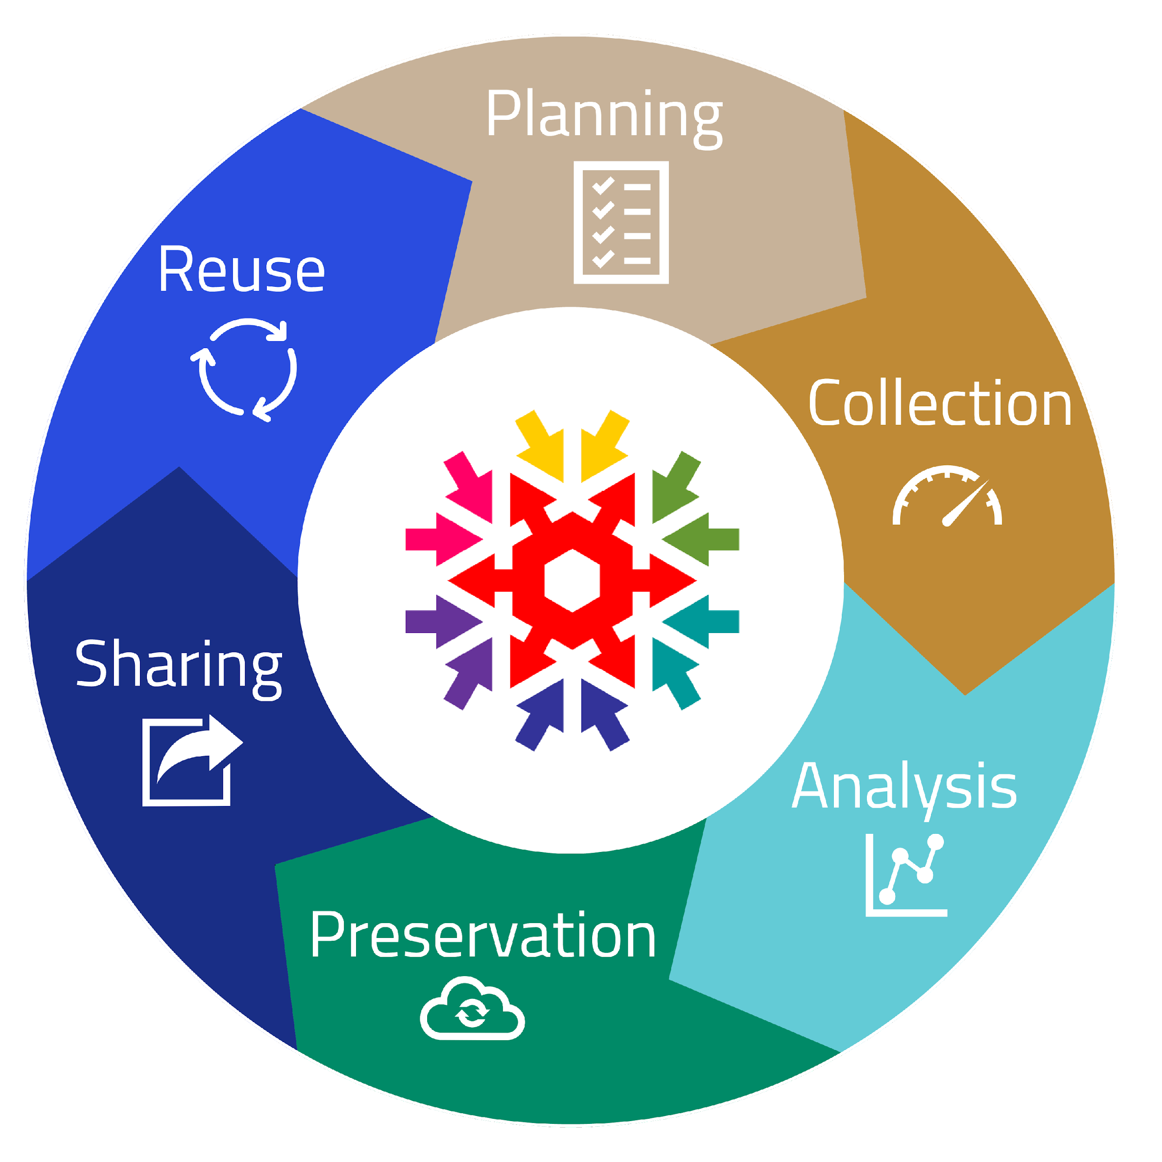
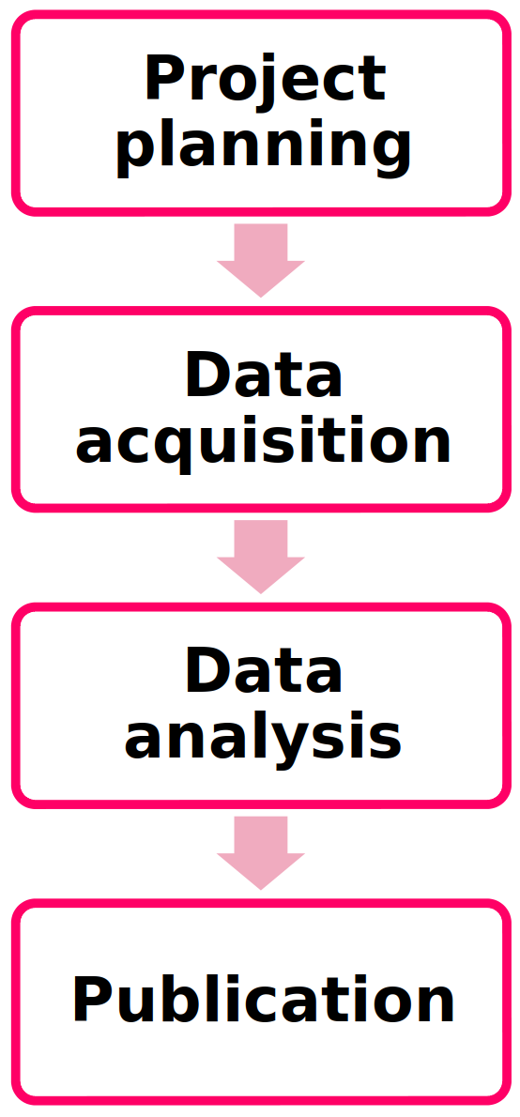
Introduction to RDM in Materials Science
When and how to prepare a RDM plan?
The data life cycle → describes the lifespan of the data → following this cycle directly improves your research on the short and the long term.
Modern life cycle
Old life cycle

Slide 9








Introduction to RDM in Materials Science
When and how to prepare a RDM plan?
The data life cycle → describes the lifespan of the data → following this cycle directly improves your research on the short and the long term.
No need to reinvent the wheel, but actually build on existing infrastructure → several databases for Materials Science data:

Slide 10
F.A.I.R. principles
Raw data vs Metadata
Data that explains the data → makes raw data understandable.
Makes data searchable.
Human- and Machine-readable → metadata schemas are pairs of `key: value` (dictionaries).

Slide 11
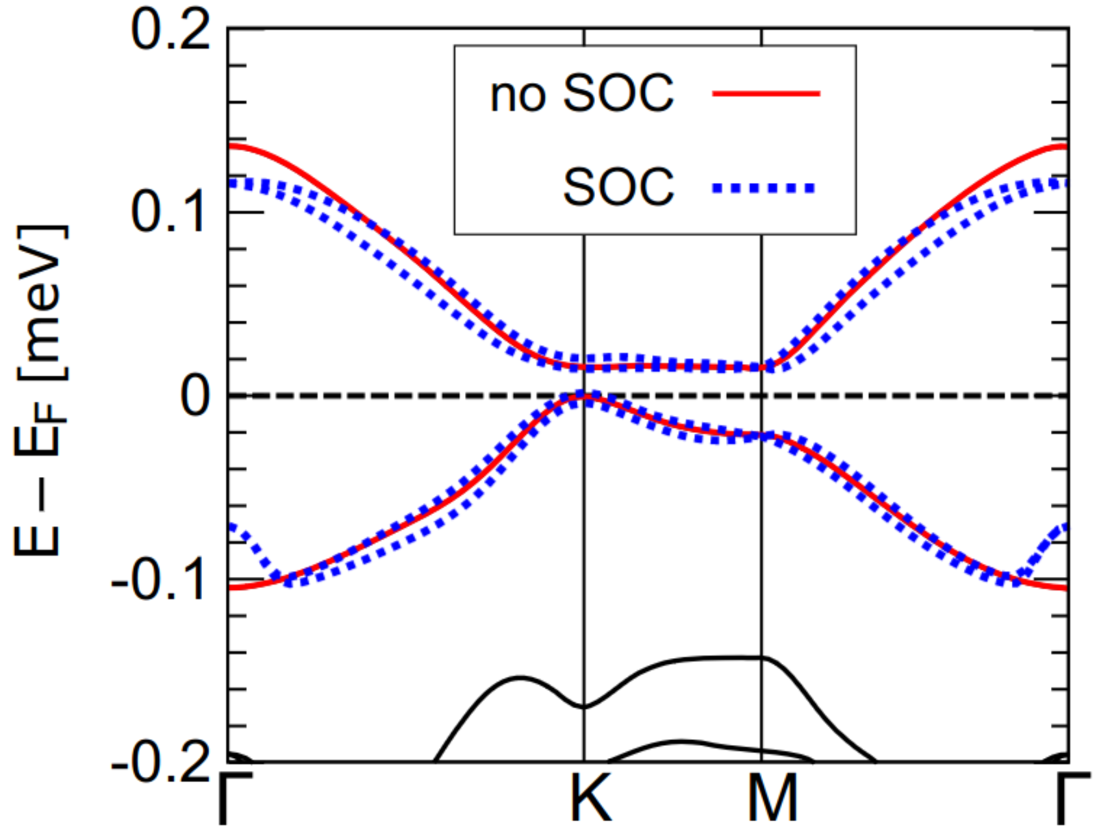
F.A.I.R. principles
Raw data vs Metadata
Let’s see an example:
J.M. Pizarro et al, npj Quantum Materials 5 (2020)

Slide 12
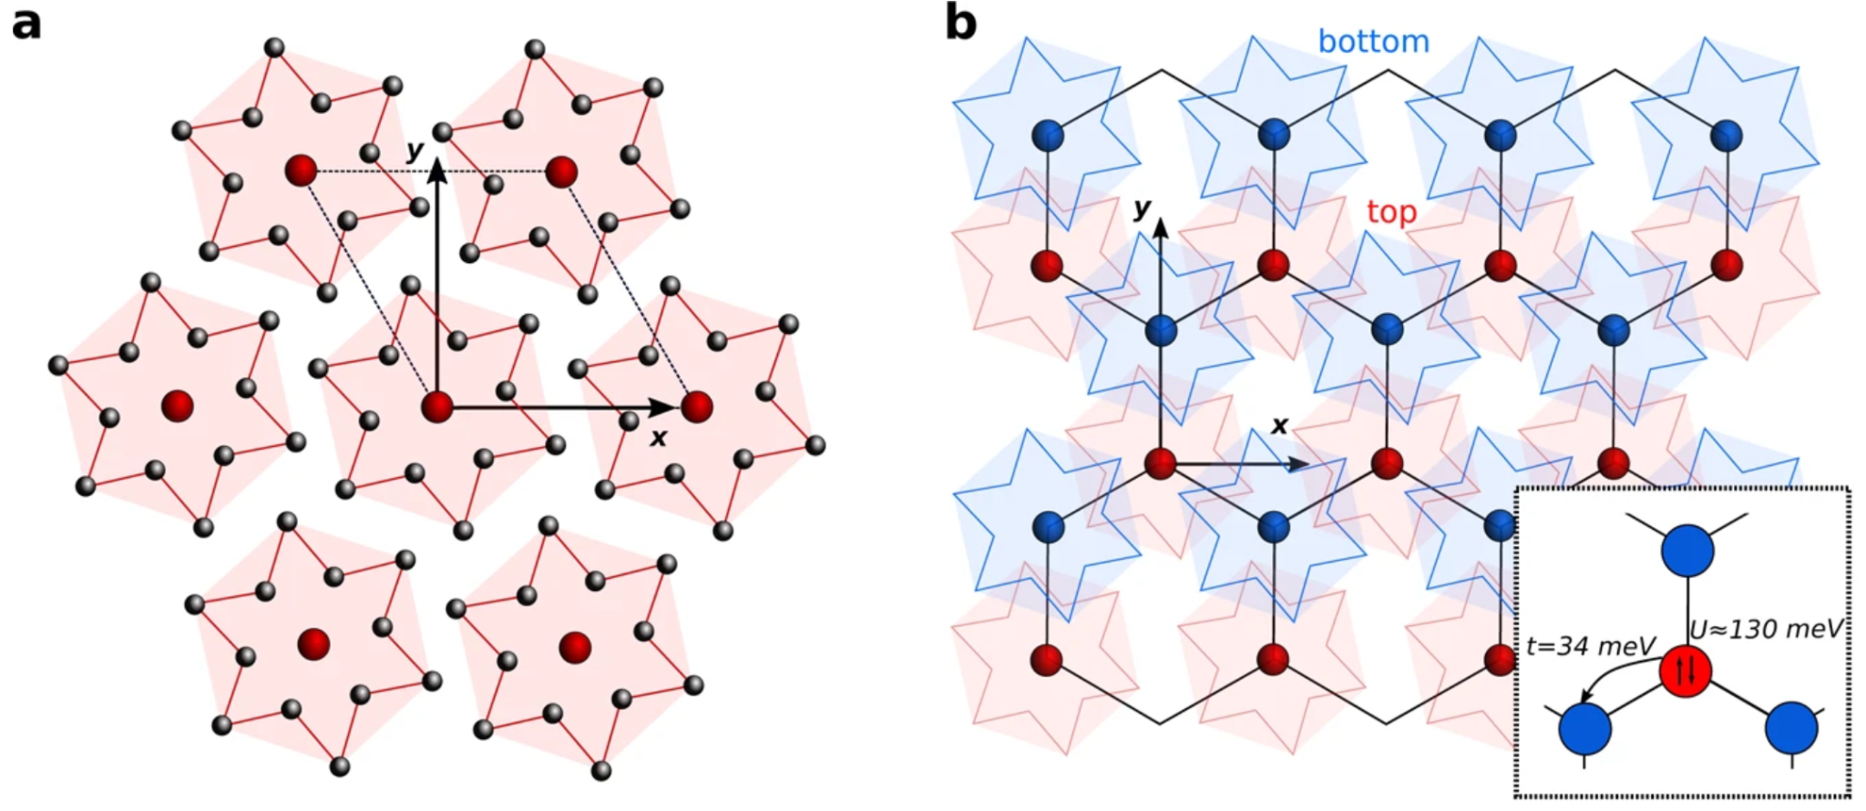
Band structure
E - EF
K space
J.M. Pizarro et al, npj Quantum Materials 5 (2020)

Slide 13
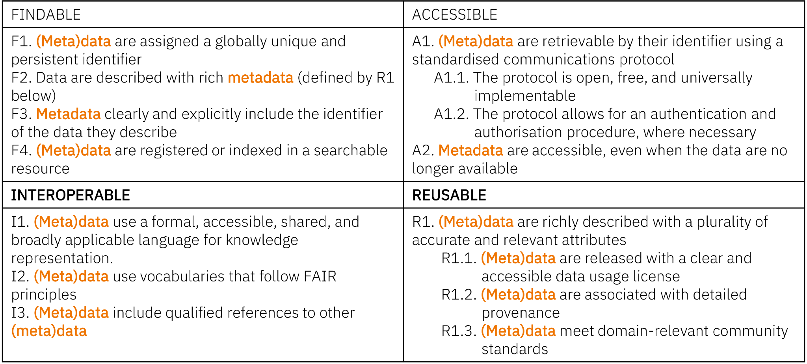
F.A.I.R. principles
https://www.go-fair.org/fair-principles/

Slide 14
F.A.I.R. principles
F: metadata should be easy to find for humans and computers: descriptive.
A: users need to have easy access the metadata (by authentication / authorisation).
I: integration with other types of data: controlled vocabulary, ontologies.
R: reusability of metadata in different settings: detailed provenance, domain community standards.
It has also an alternative meaning: Findable and AI-Ready.

Slide 15
Let’s revisit the survey

Slide 16
Schedule
Introduction to Research Data Management in Materials Science (~30min)
FAIRmat and the NOMAD Archive & Repository (~20min)
Break (~10min)
Hands-on NOMAD (~30min)

Slide 17
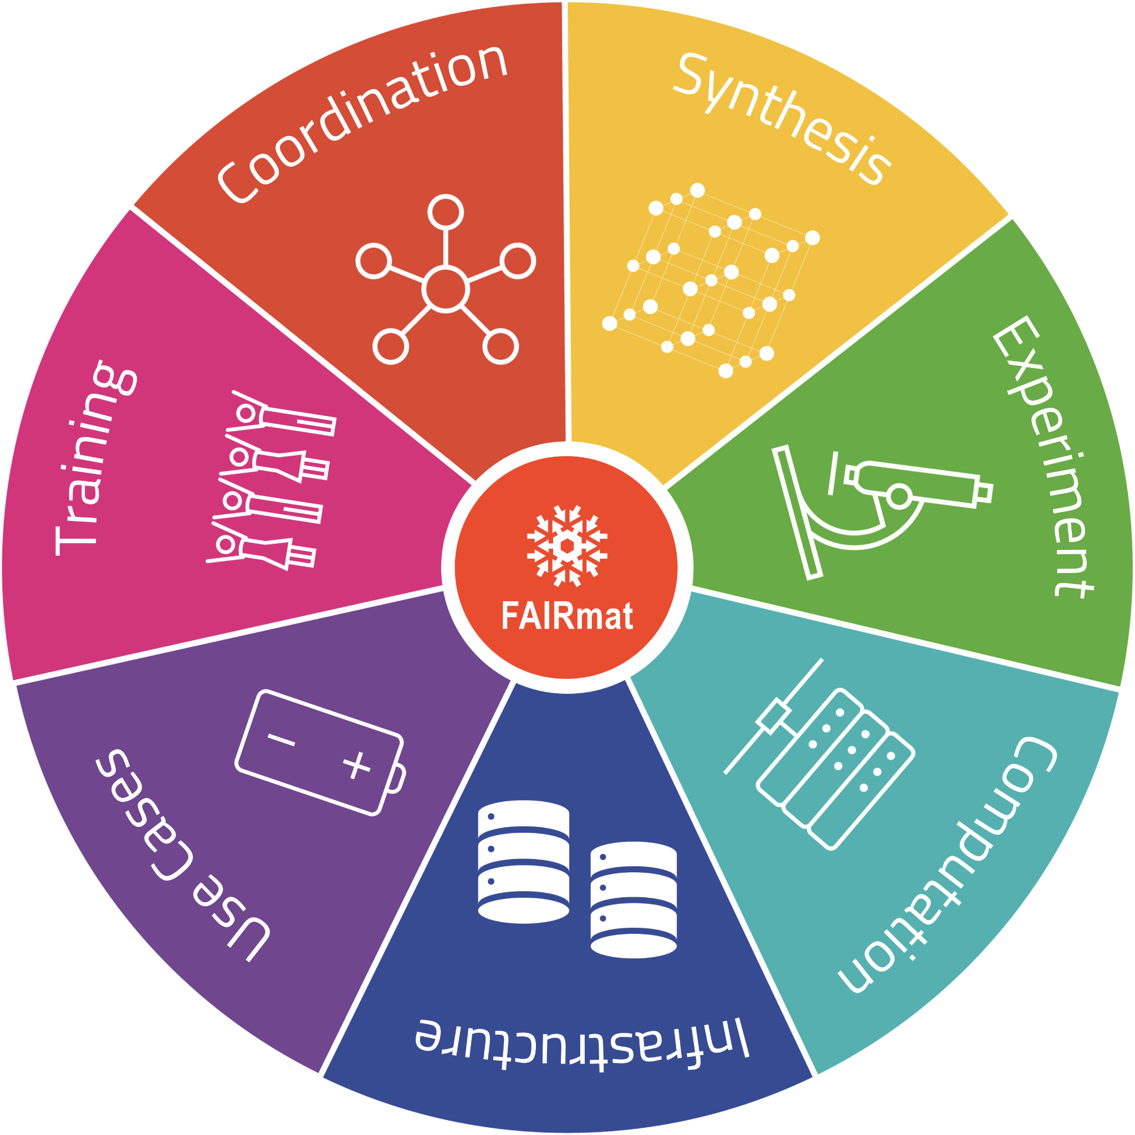
FAIRmat
Building a FAIR data infrastructure for Materials Science research data using the NOMAD Archive & Repository.
New project (started funding 2021, until 2026 plus 5 years more extension) under the NFDI (“Nationale Forschungsdaten Infrastruktur”), Germany.

Slide 18
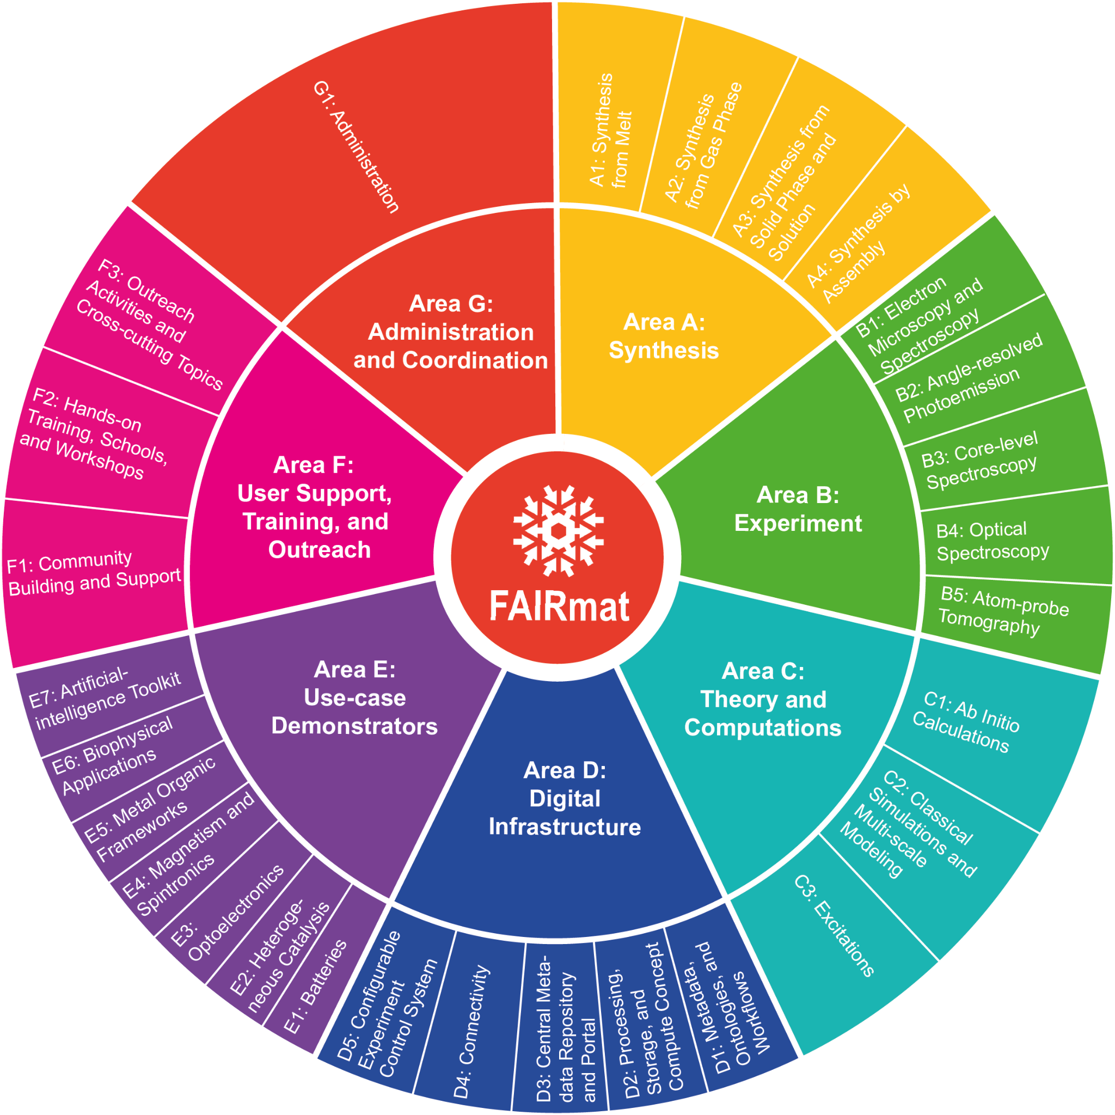
FAIRmat
Building a FAIR data infrastructure for Materials Science research data using the NOMAD Archive & Repository.
Huge team and community-driven effort.

Slide 19
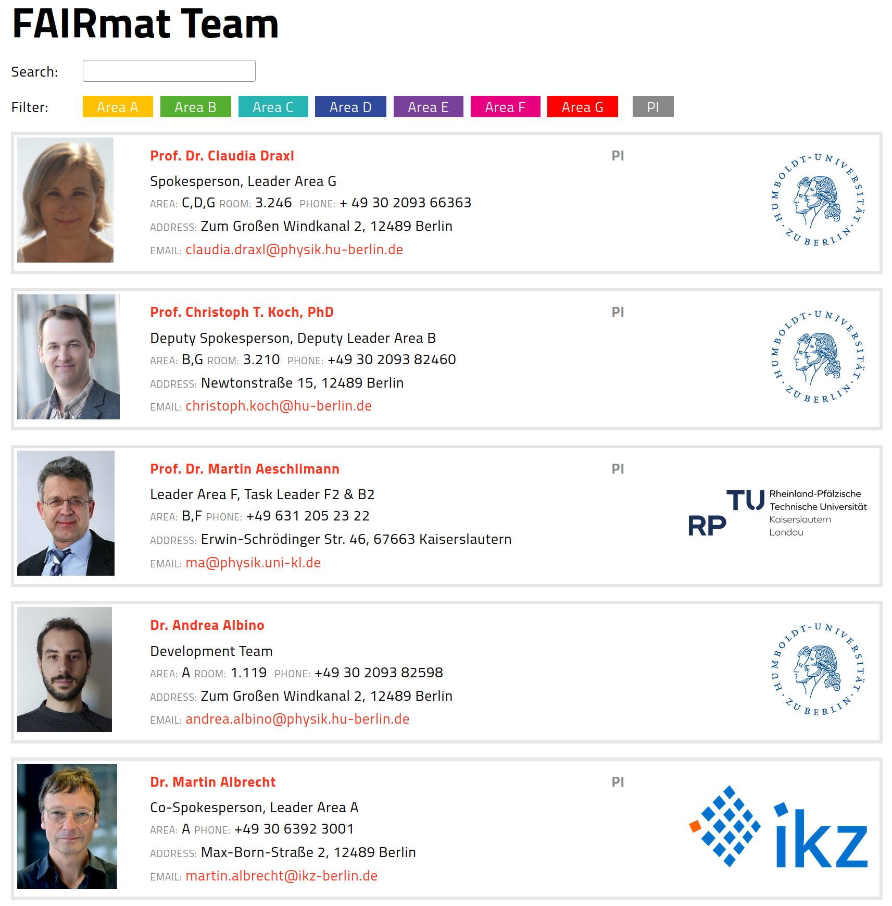
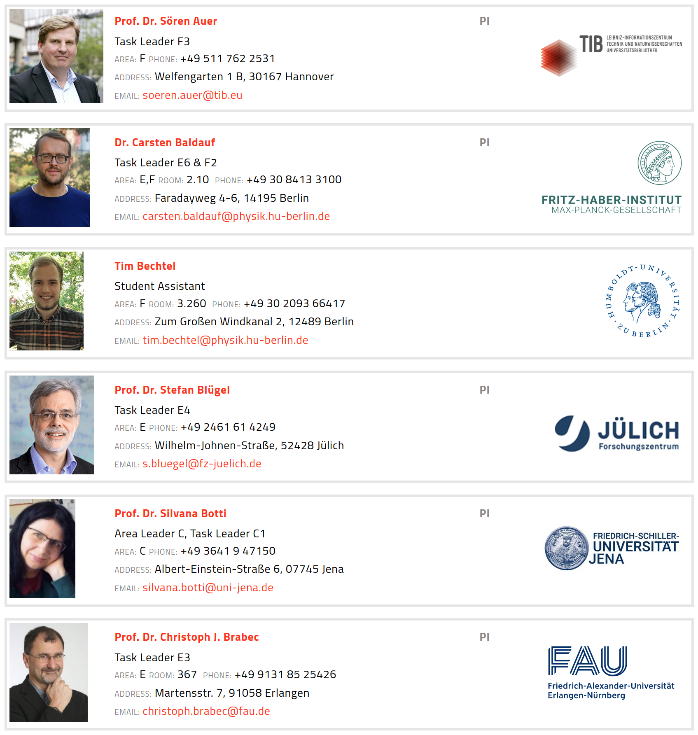
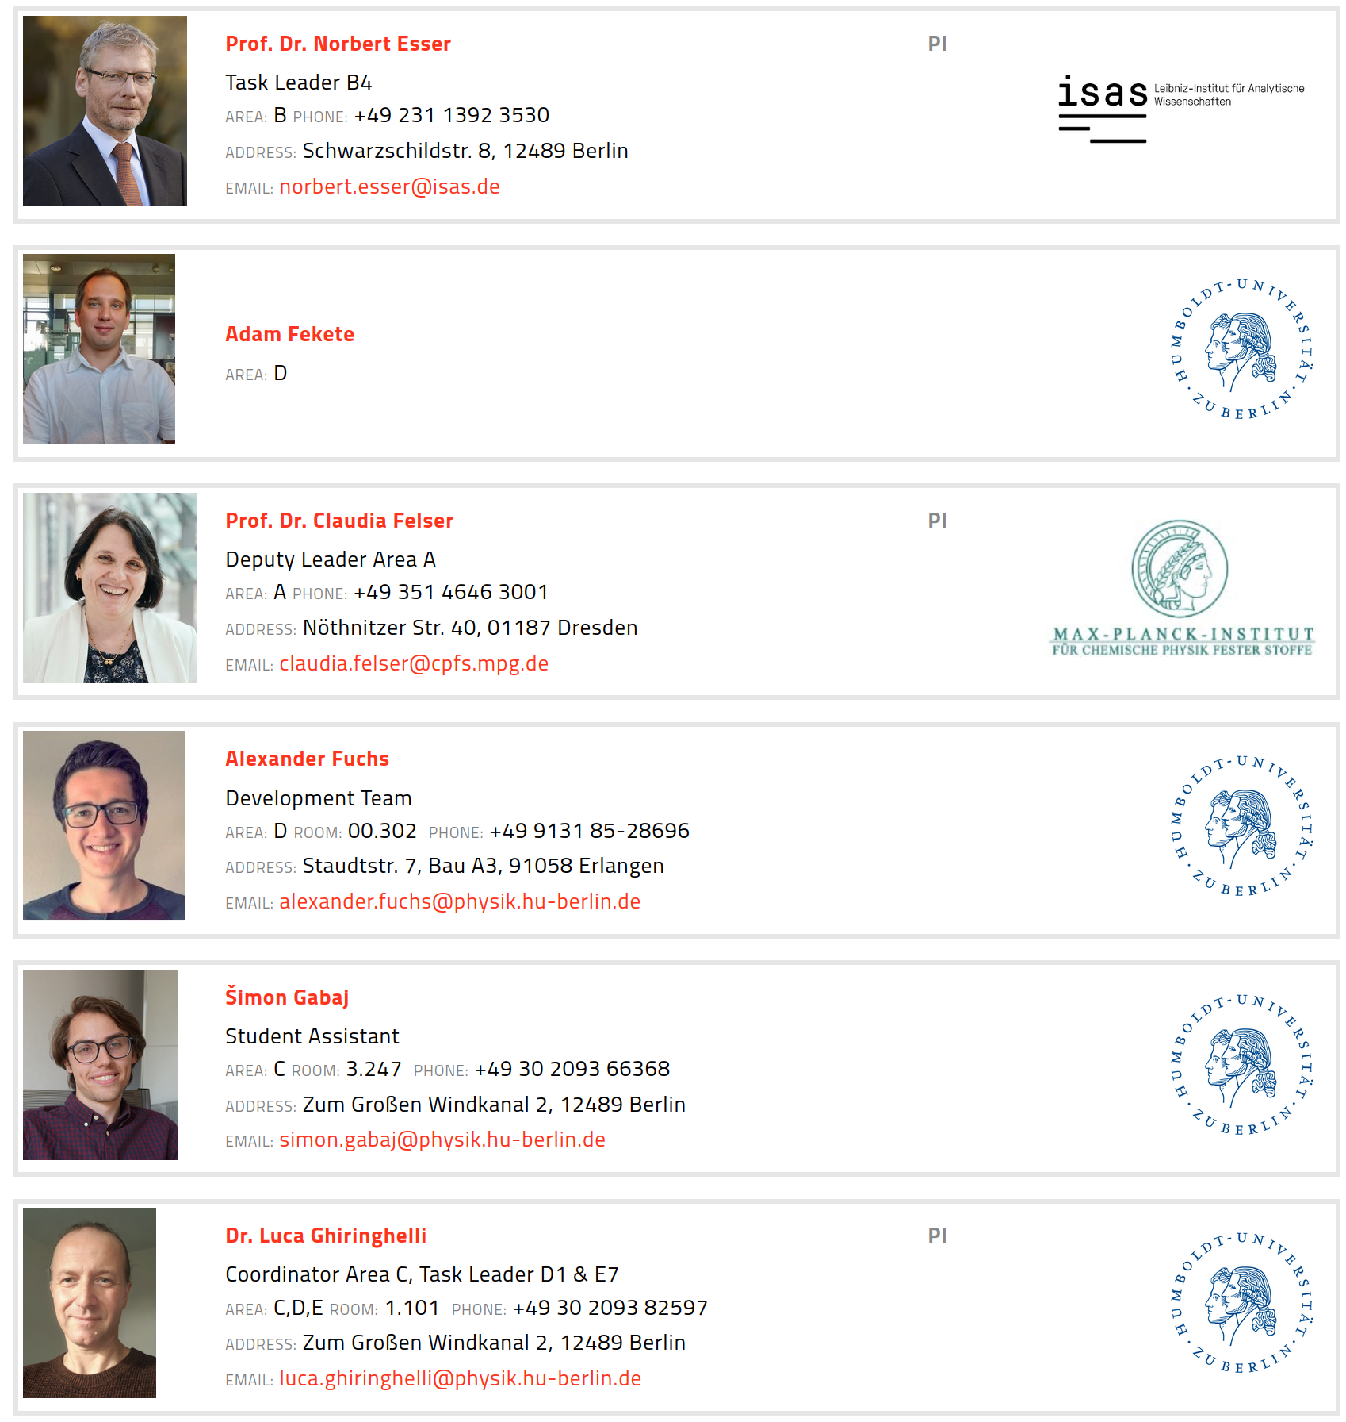
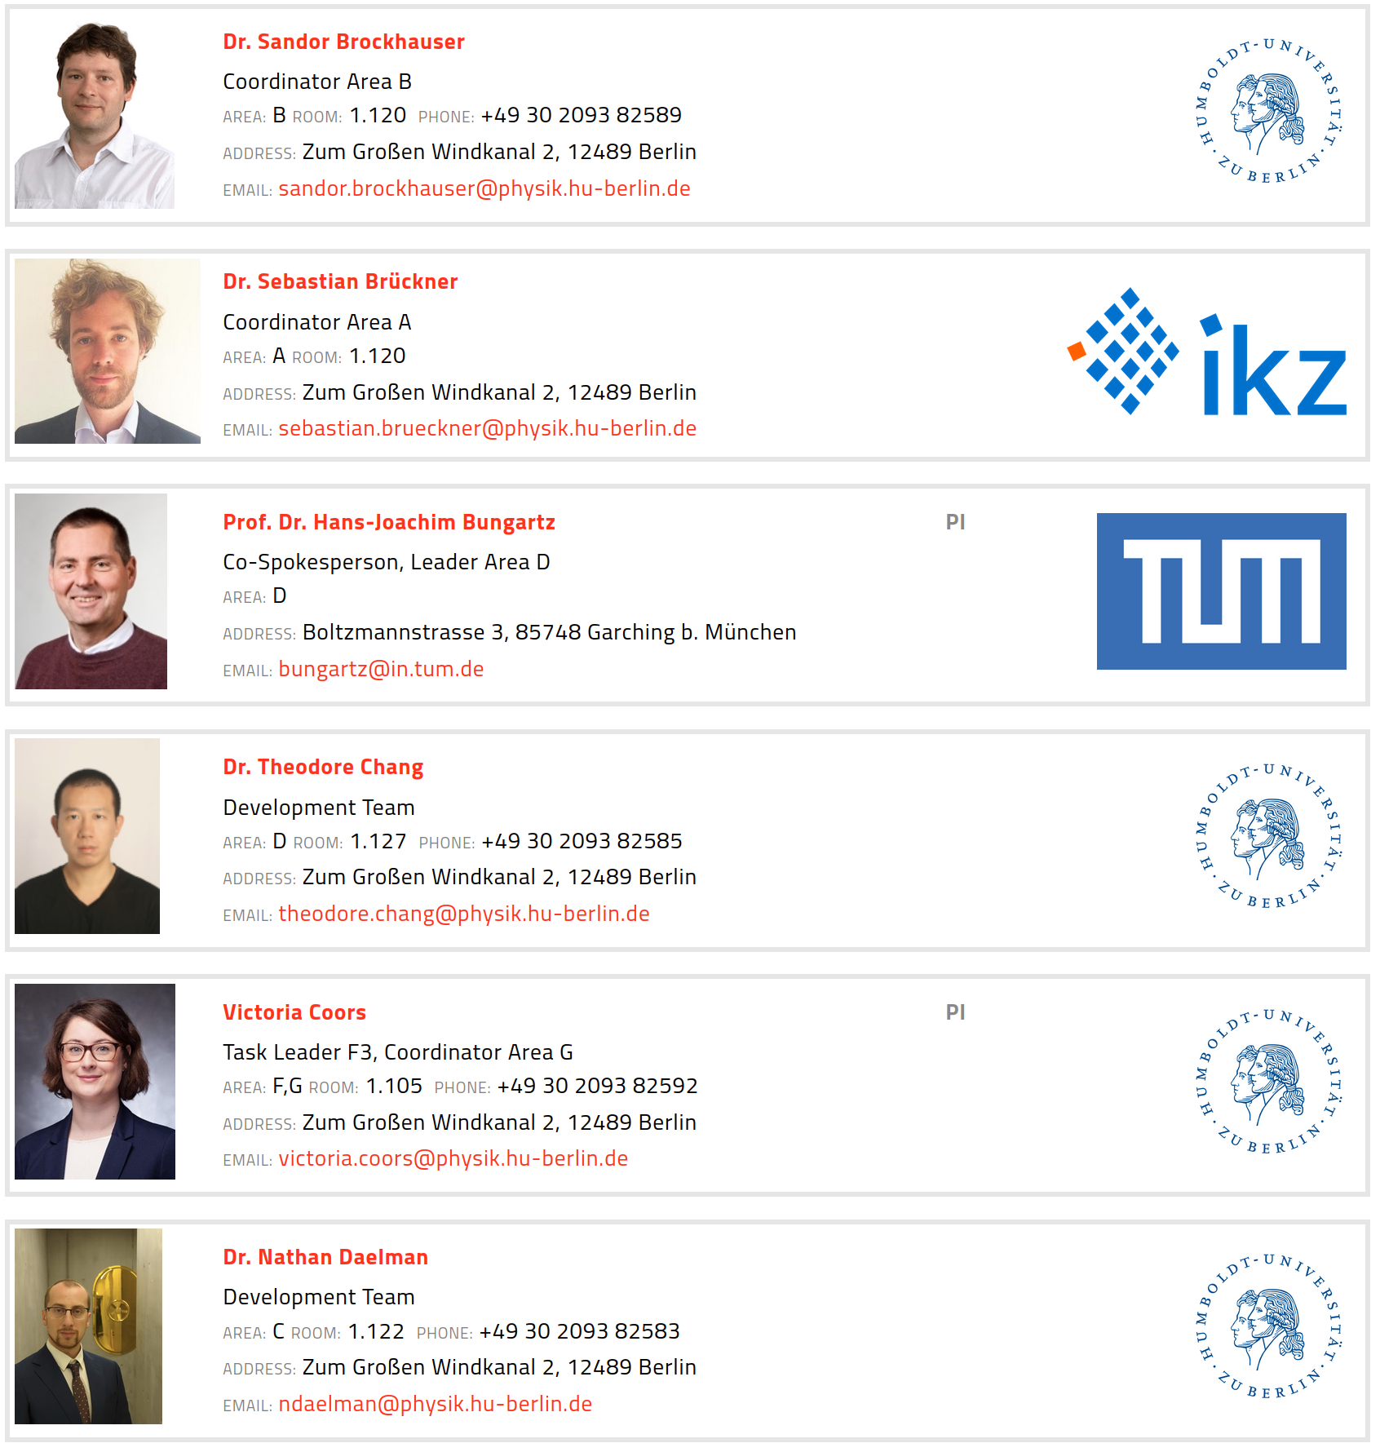
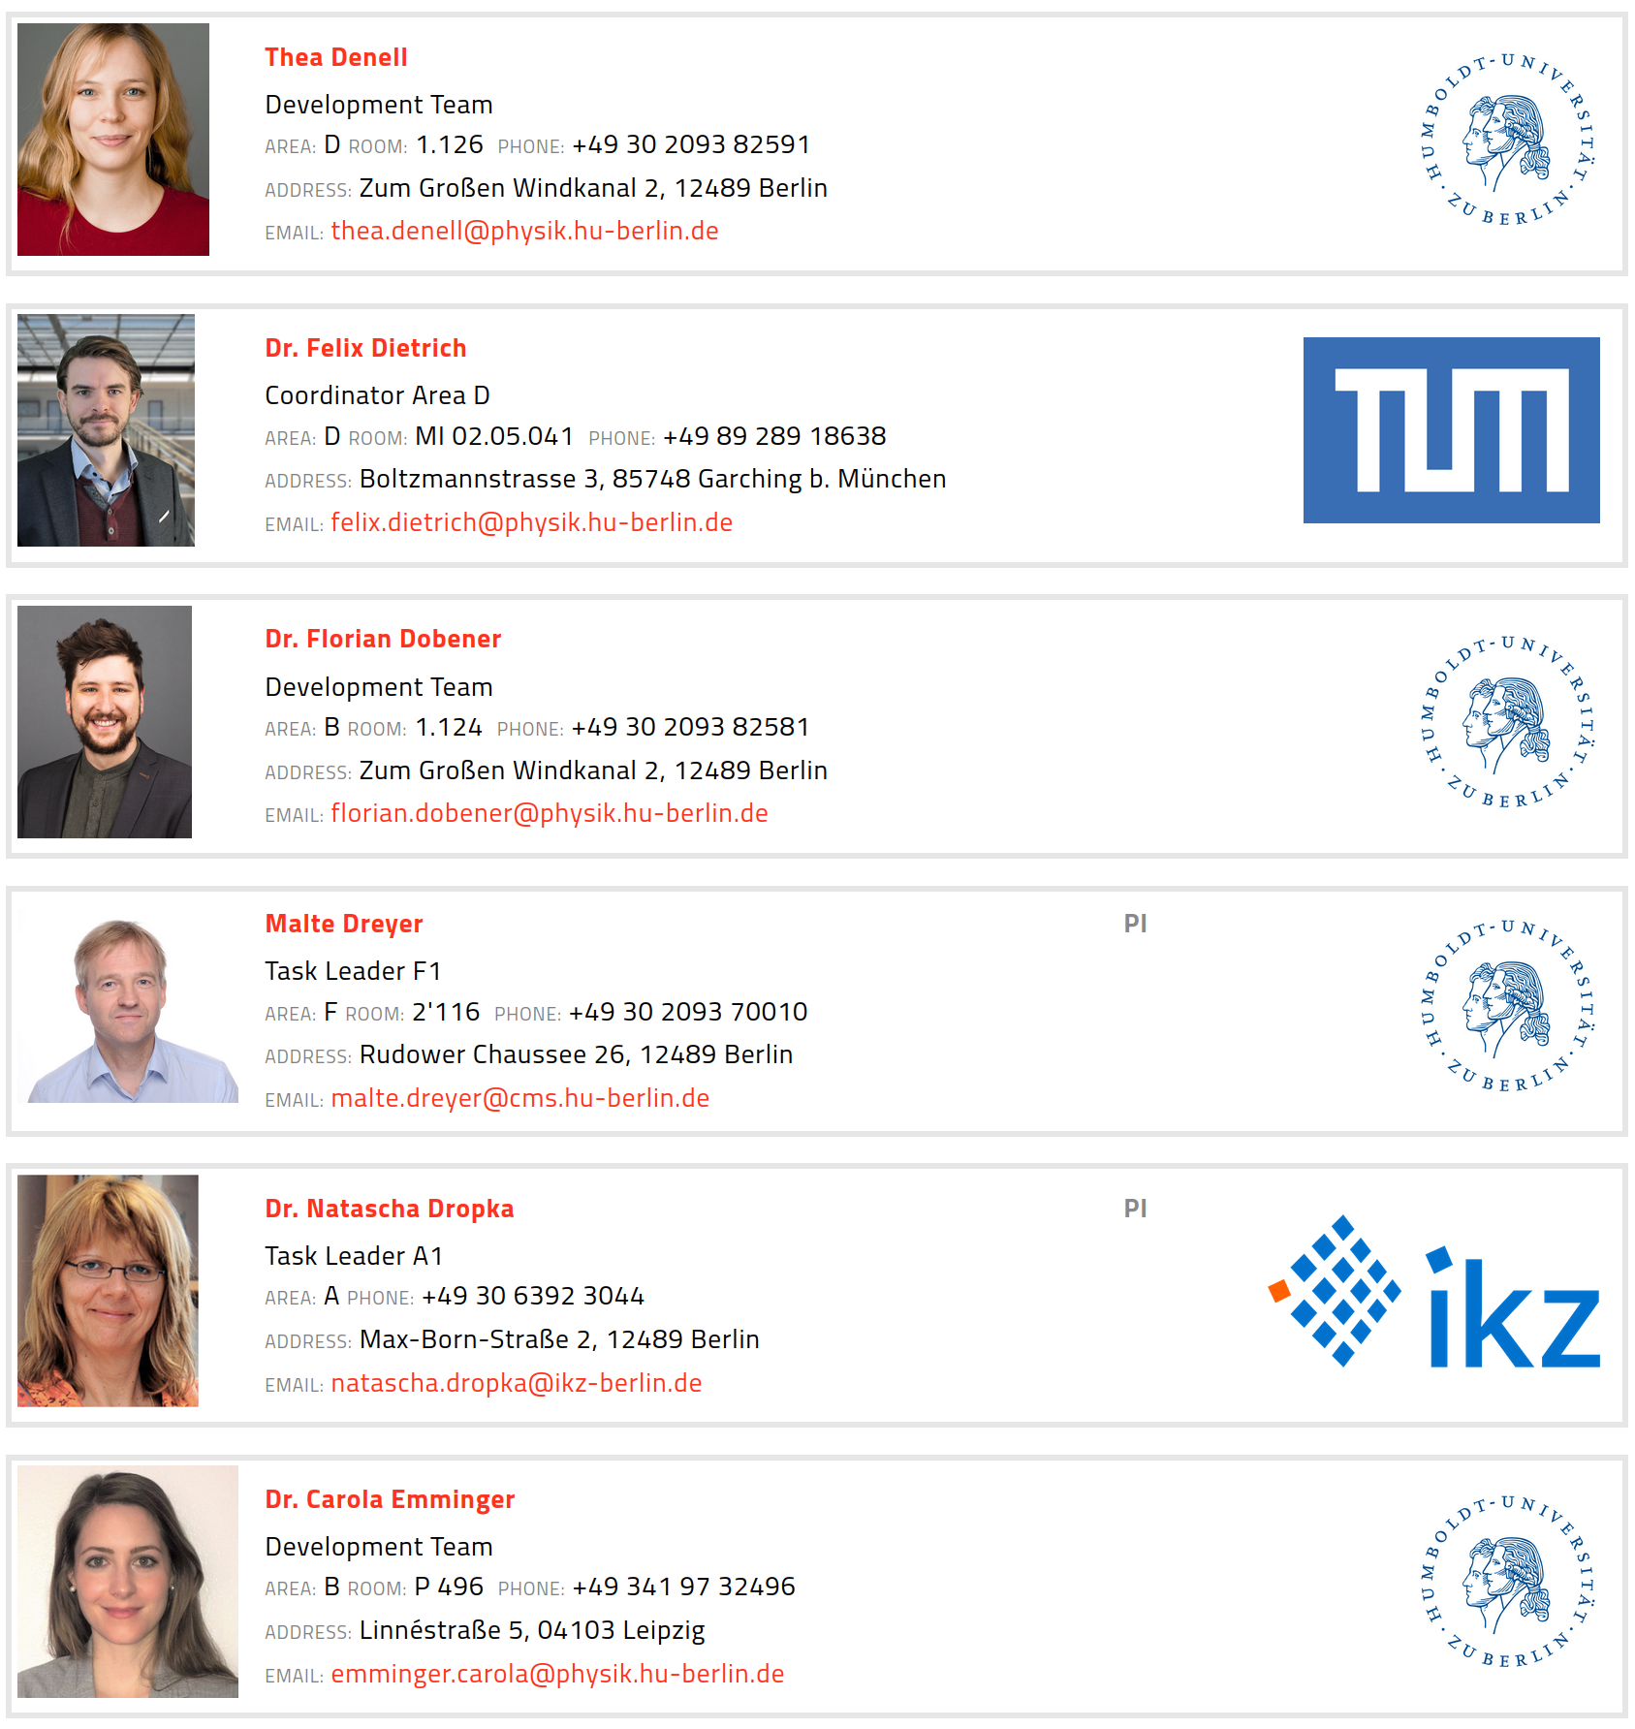
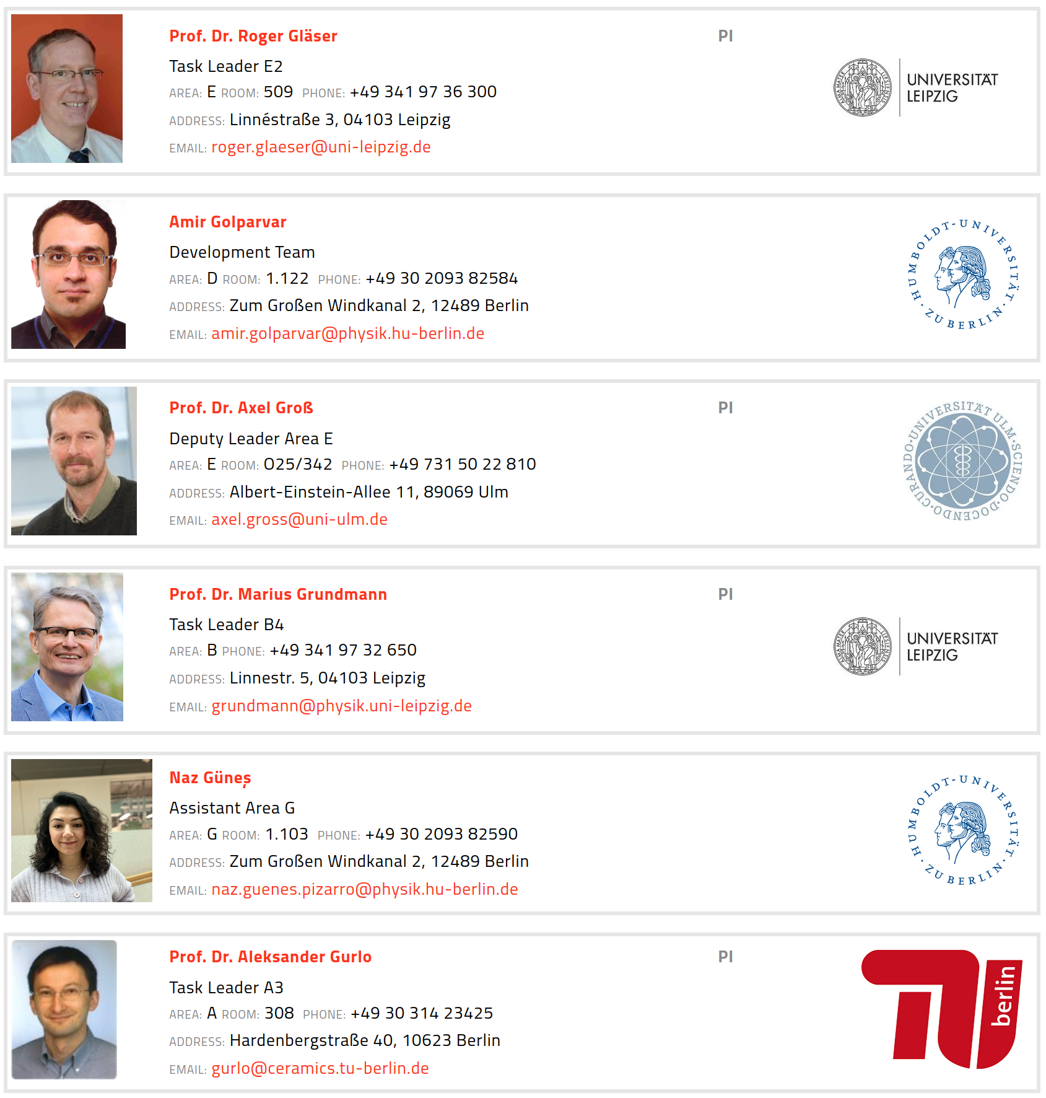
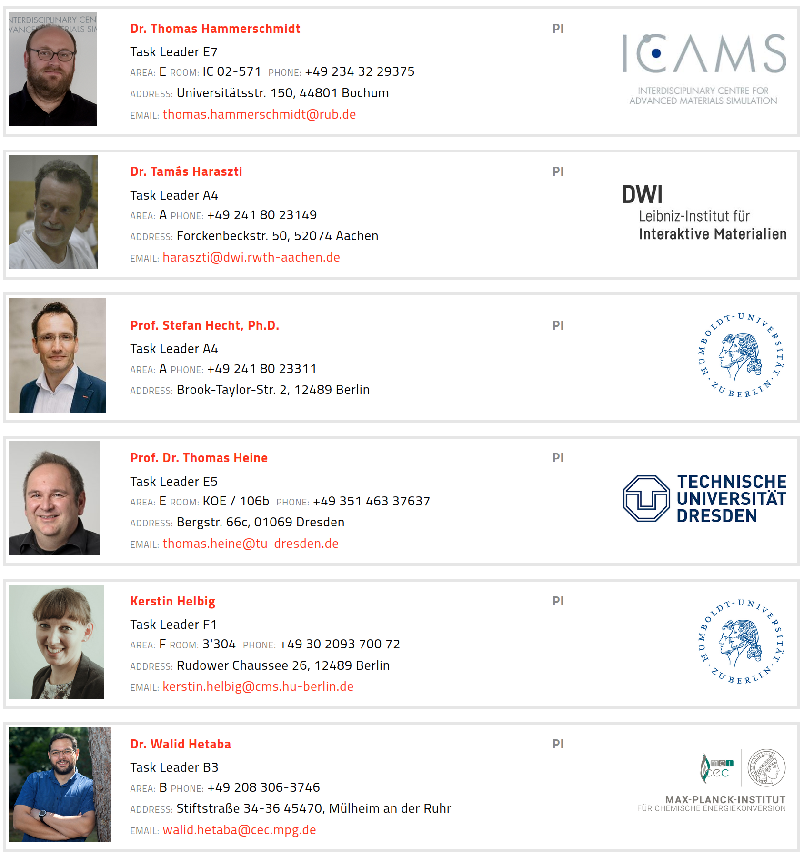
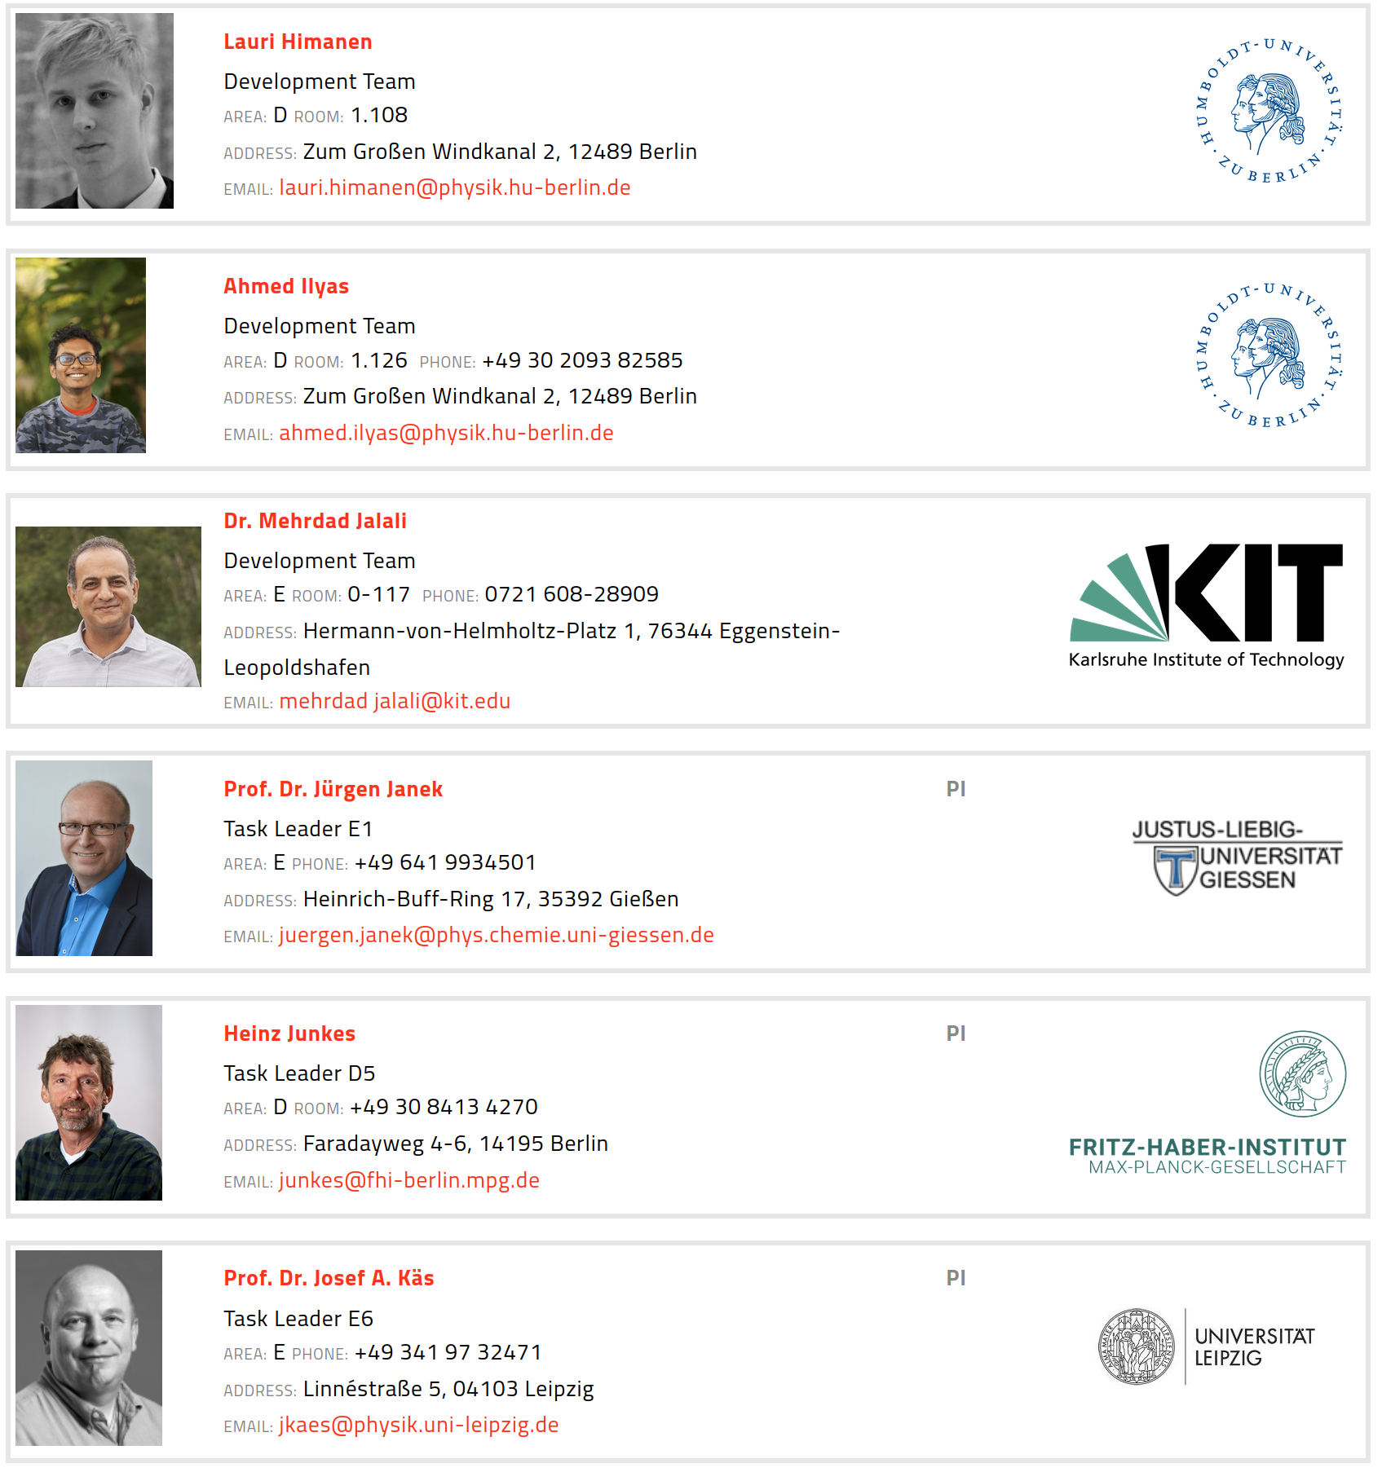
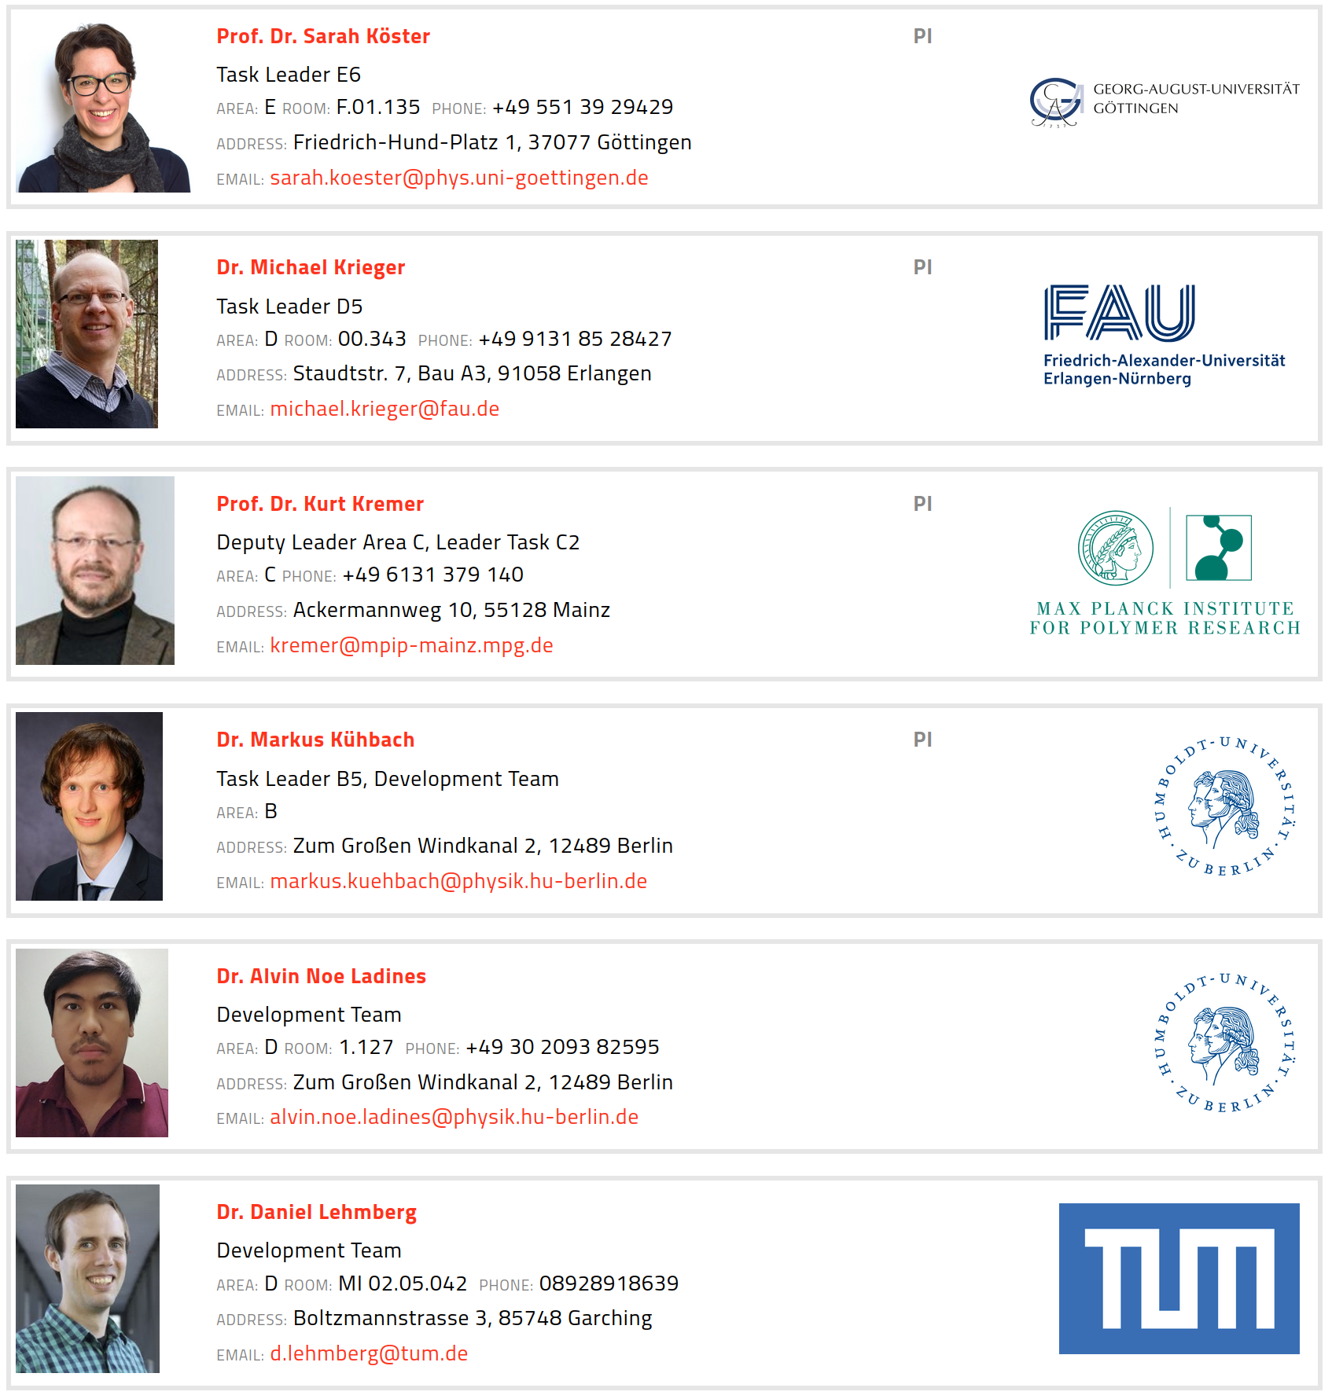
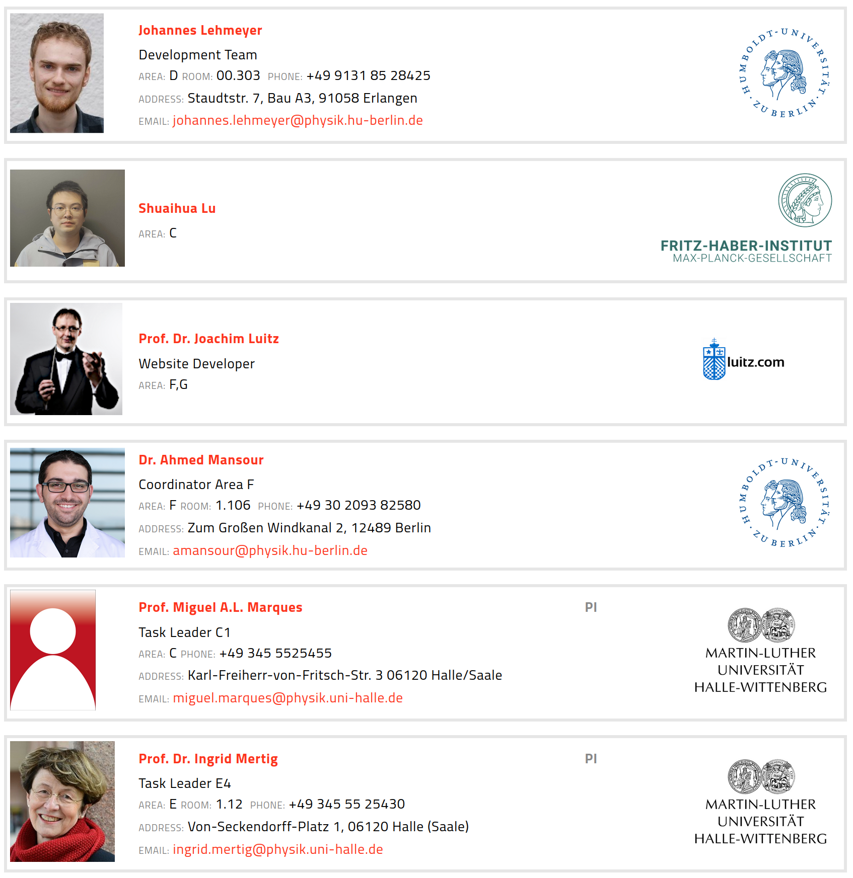
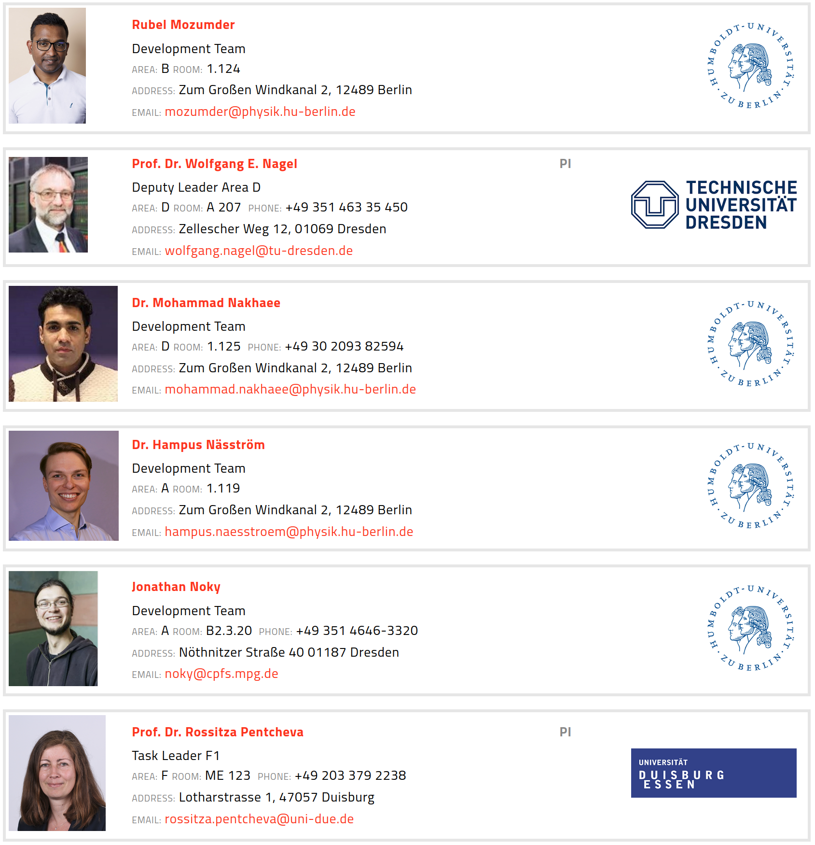
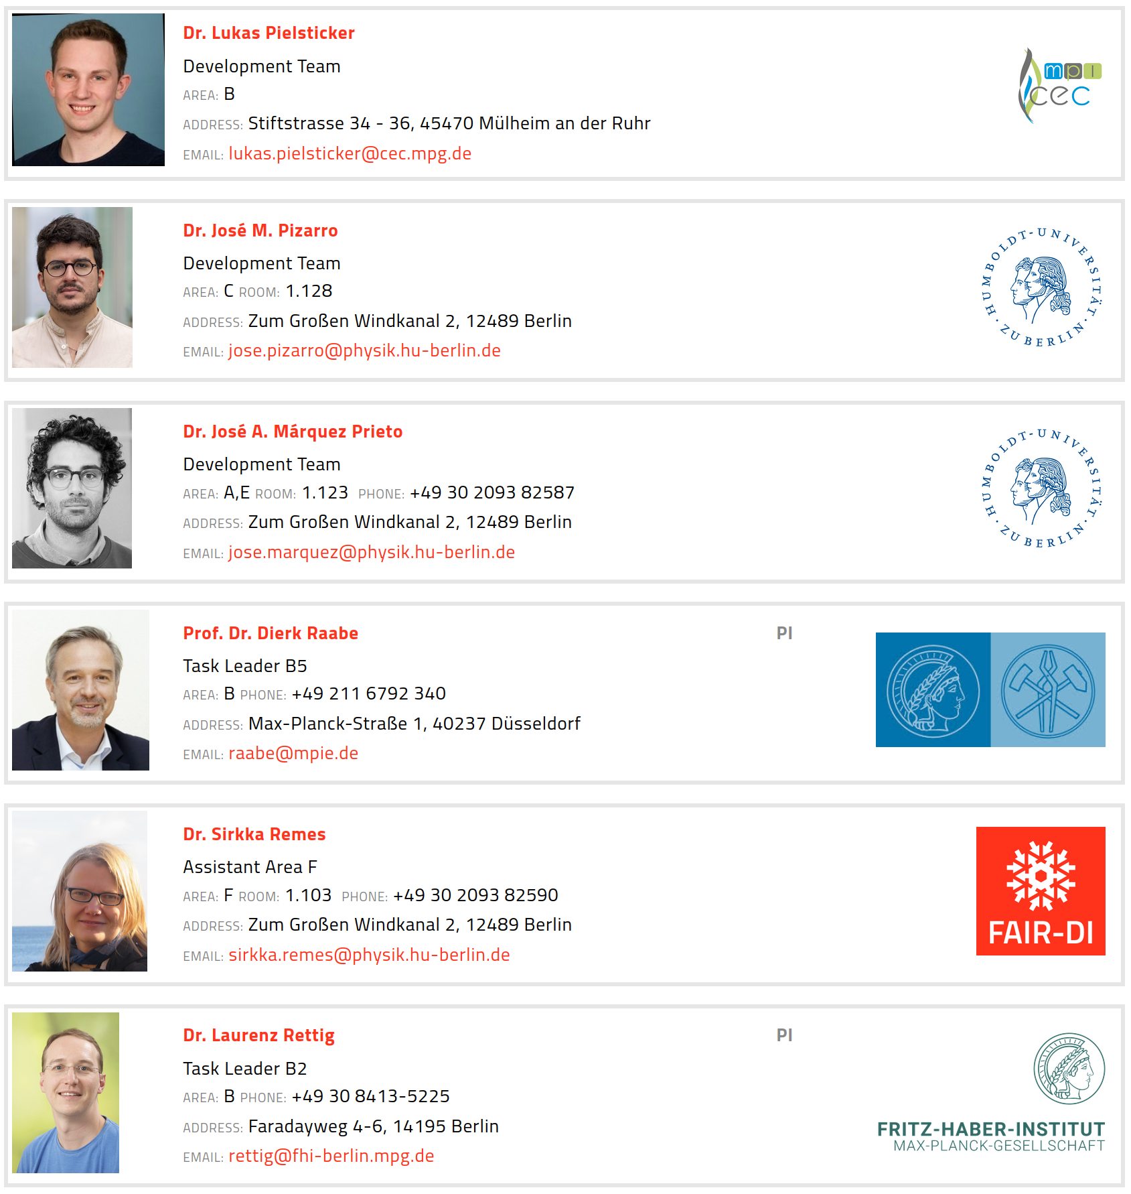

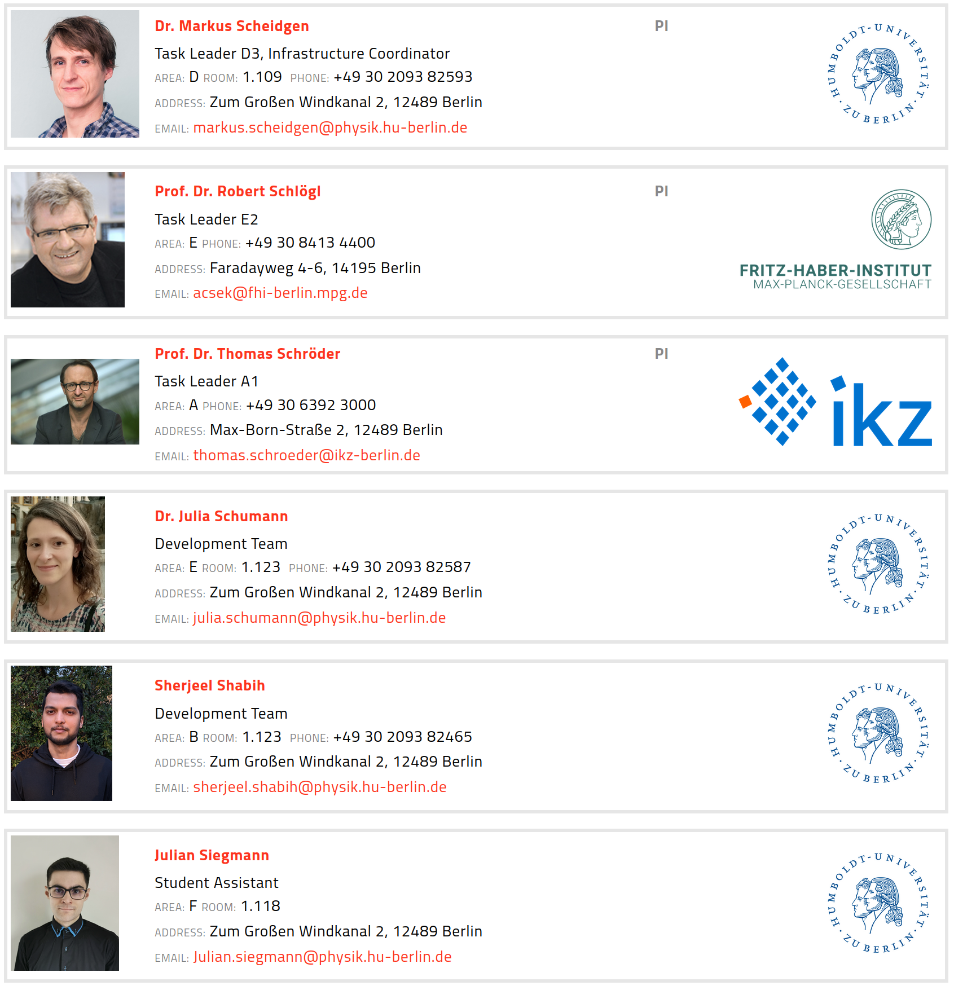
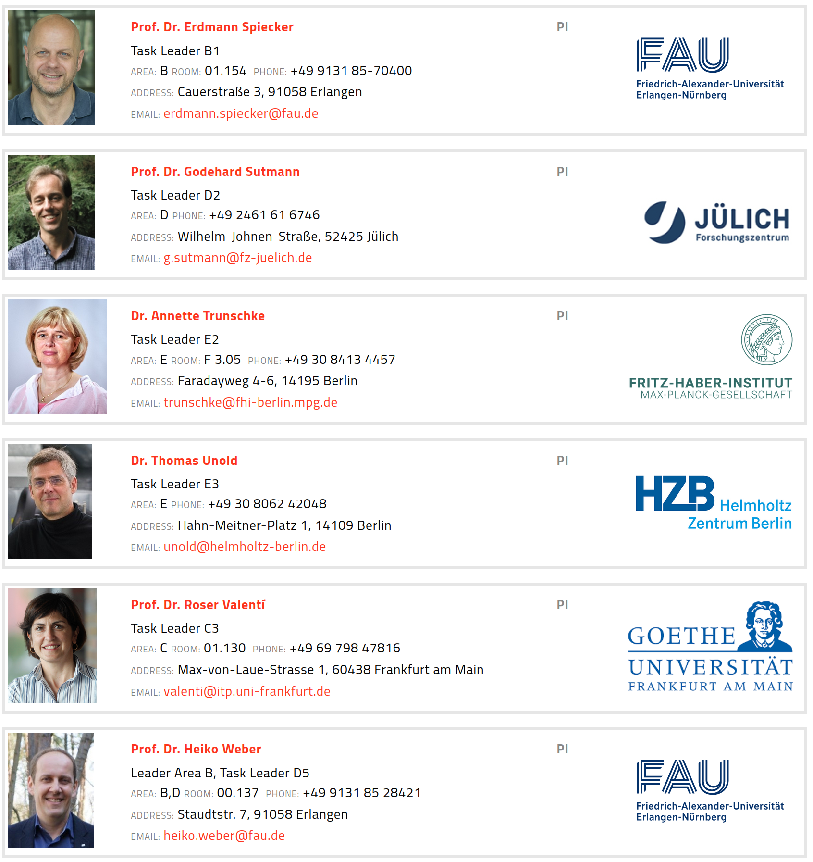
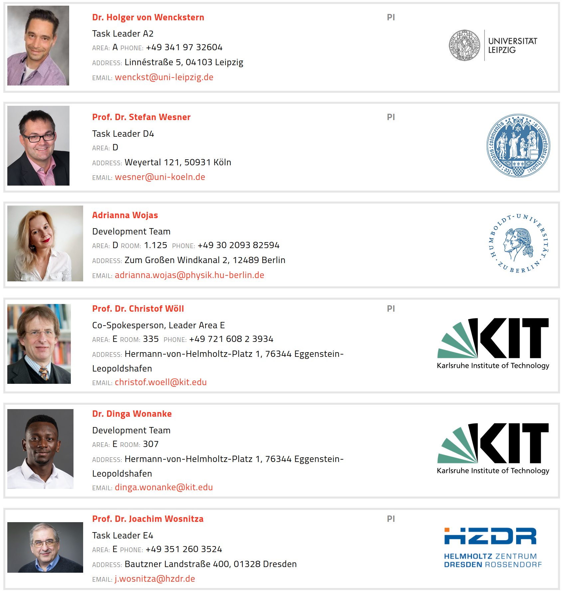
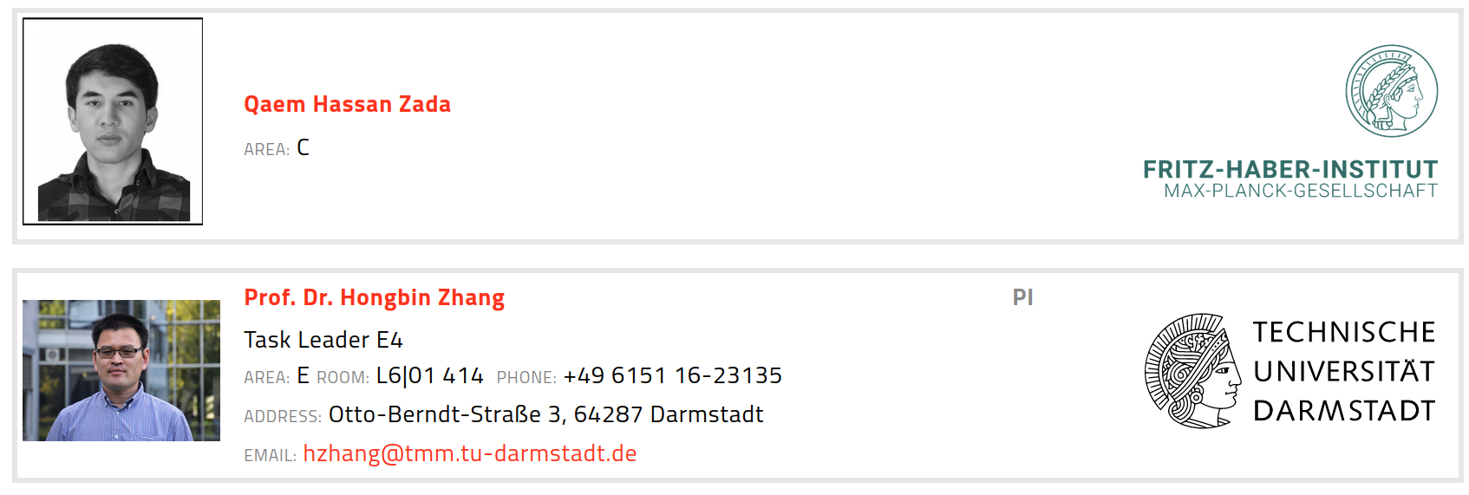
Building a FAIR data infrastructure for Materials Science research data using the NOMAD Archive & Repository.
Huge team and community-driven effort.
~40 coworkers, ~60 PIs, ~40 supporting institutions, ~30 research projects

Slide 20
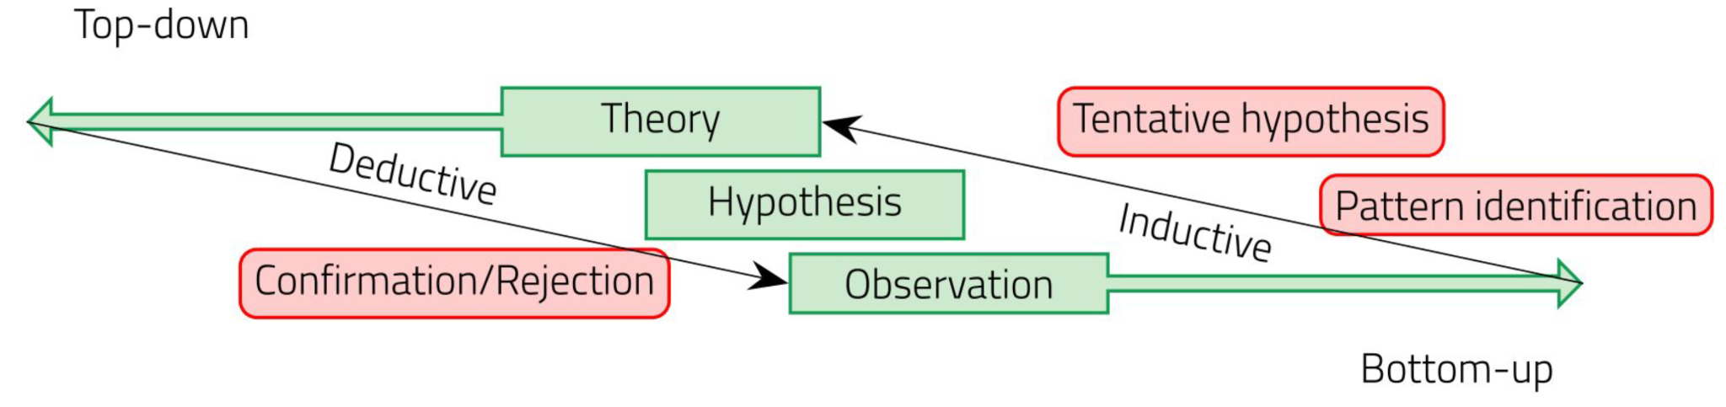
FAIRmat
Building a FAIR data infrastructure for Materials Science research data using the NOMAD Archive & Repository.
NOMAD started in 2014 with DFT data → current effort is focused on extending the infrastructure and build Interoperability across “Areas”.
Defining metadata schemas for Materials Science Synthesis, Characterization, and Computational data

Slide 21
FAIRmat Area C team

Slide 22

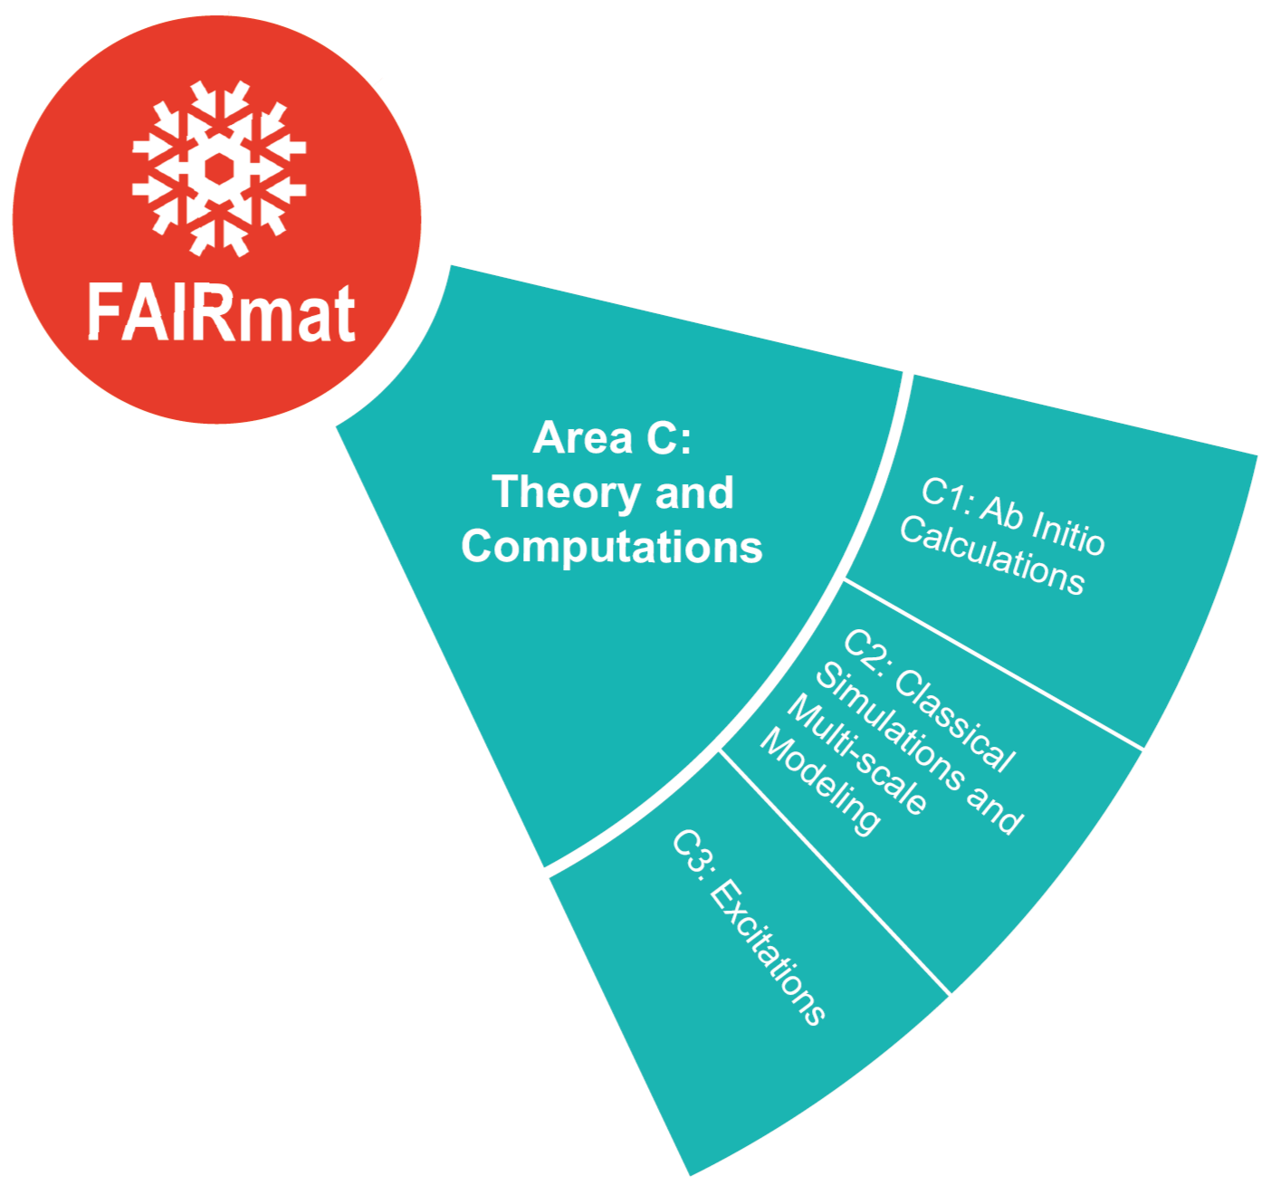
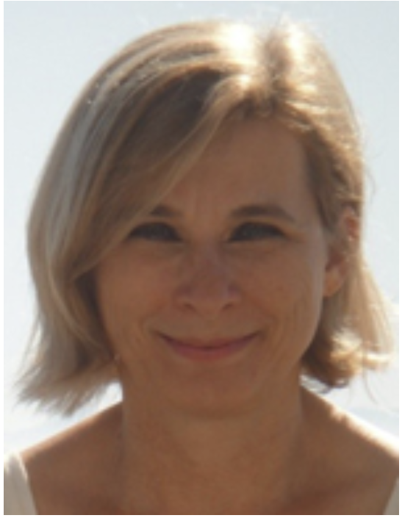
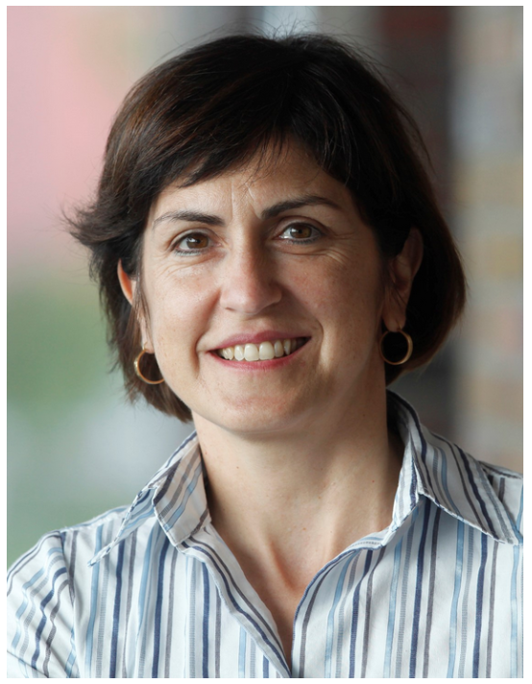

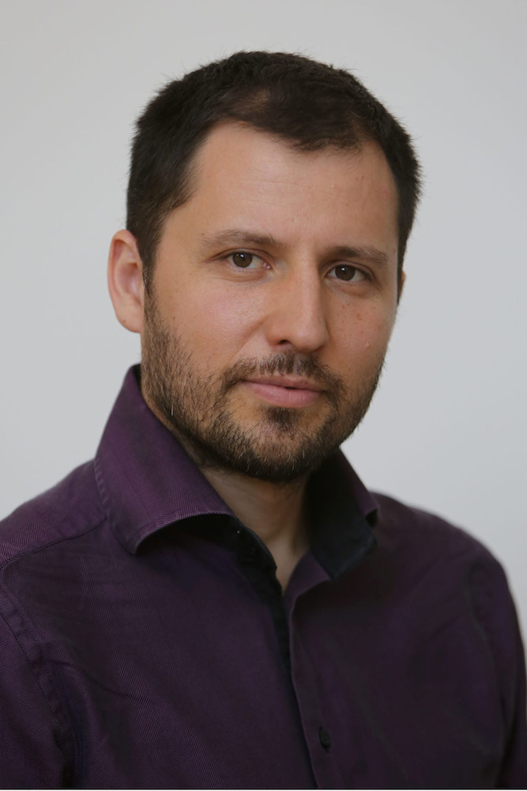

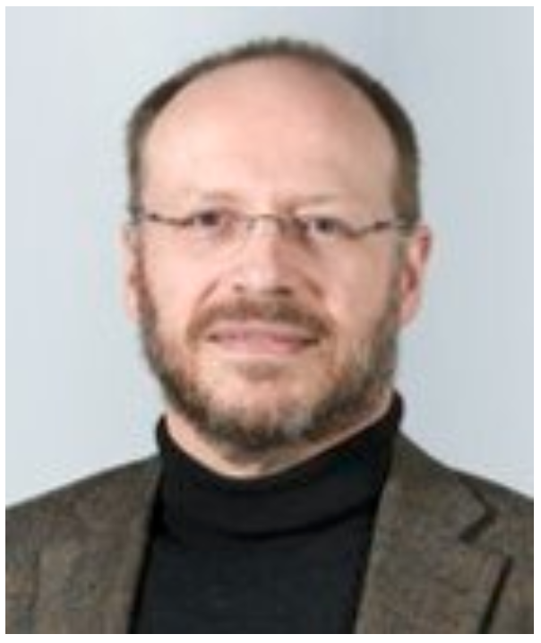

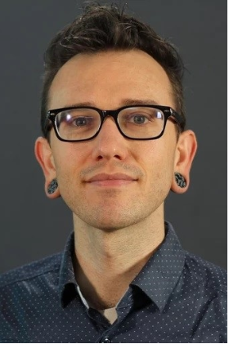



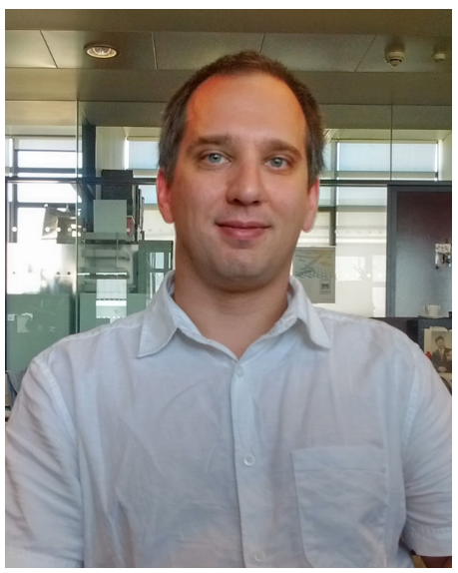

FAIRmat Area C team
Silvana Botti
Luca M. Ghiringhelli
Claudia Draxl
Roser Valentí
Miguel A.L. Marques
Nathan Daelmann
Kurt Kremer
Karsten Reuter
Joseph F. Rudzinski
+ amazing support by Area D devs and engineers
José M. Pizarro
Markus Scheidgen
Alvin Noe Ladines
Lauri Himanen
Adam Fekete

Slide 23
Schedule
Introduction to Research Data Management in Materials Science (~30min)
FAIRmat and the NOMAD Archive & Repository (~20min)
Break (~10min)
Hands-on NOMAD (~30min)

Slide 24
Schedule
Introduction to Research Data Management in Materials Science (~30min)
FAIRmat and the NOMAD Archive & Repository (~20min)
Break (~10min)
Hands-on NOMAD (~30min)

Slide 25
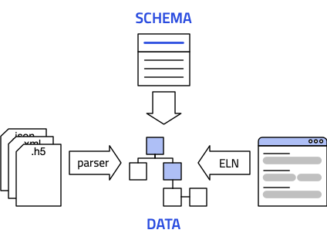
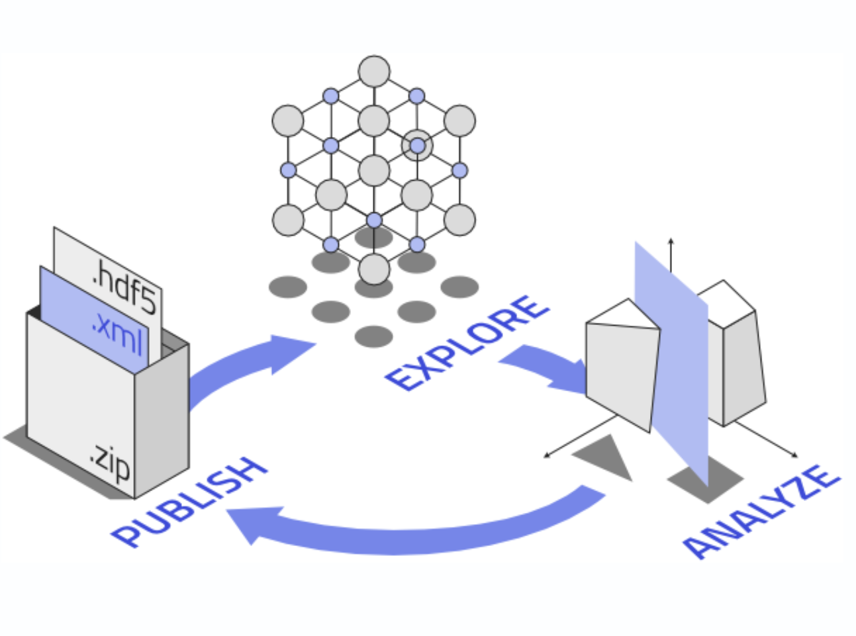
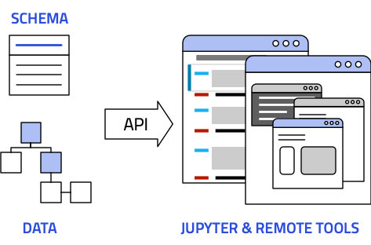
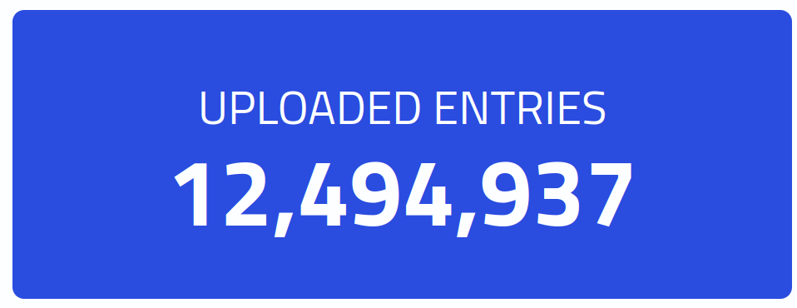
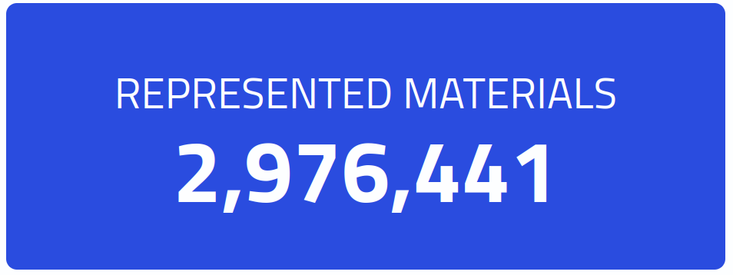
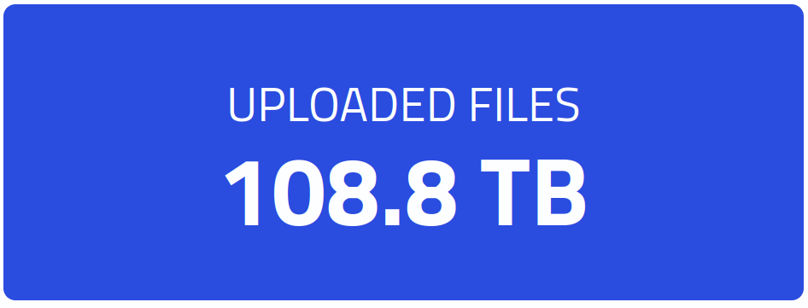
NOMAD Archive & Repository
Making materials science data
Findable
Accessible
Interoperable
Reusable
Drag and drop
Get a DOI
You control your data
Central storage or
local installation
Ready to use tools
[1] Scientific Data 3, 160018 (2016). doi: 10.1038/sdata.2016.18.

